Slide 1
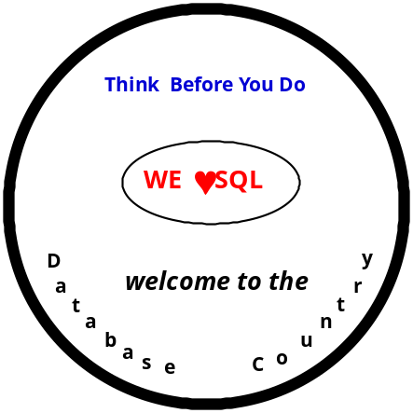
U08049 Database Design
• technological nature •
• disciplined approach •
• diverse software •
©Stefan Stanczyk U08049 – 2008

Slide 2
WHAT
Database concepts
Logical data modelling
Foundations & properties of relational databases
Design & normalisation of relational structures
Foundations & properties of OO databases
Designing OO structures
Programming in SQL & SQL extensions
©Stefan Stanczyk U08049 - 2008

Slide 3
HOW
• lectures & practicals
• Moodle web-site all TL material
• books
• email for short messages
©Stefan Stanczyk U08049 - 2008

Slide 4
BOOKS
Stanczyk, Champion & Leyton
Theory & Practice of Relational Databases (2nd ed)
Taylor & Francis, 2001
Date CJ
An Introduction to Database Systems (8th ed)
Addison-Wesley 2004
O'Neil/O'Neil
Databases - Principles, Programming, Performance (2nd ed)
Morgan Kaufmann 2001
Elmasri/Navathe
Fundamentals of Database Systems (3rd ed.)
Addison Wesley 2000
Korth /Silberschatz
Database System Concepts (3rd ed)
McGraw Hill 2001
©Stefan Stanczyk U08049 - 2008

Slide 5
WEB SITE
http://moodle.brookes.ac.uk
©Stefan Stanczyk U08049 - 2008

Slide 6

Database Foundations
©Stefan Stanczyk U08049 - 2008

Slide 7








WHAT SO GREAT ABOUT DB?
DATA
DATA
DATA
COLLECTION
COLLECTION
COLLECTION
OWN
DATA
FILES
OWN
DATA
FILES
OWN
DATA
FILES
OWN
OWN
OWN
PROCESSES
PROCESSES
PROCESSES
Pascal
Java
C
Application A
Project
Control
Application B
Personnel
Info System
Application C
Financial
Info System
©Stefan Stanczyk U08049 - 2008

Slide 8
• Redundancy of data
• Non-interchangeability of data
• Non-interchangeability of processes
• Non-transparency of the application software
• Inflexibility of the application software
• Uncontrolled expansion
©Stefan Stanczyk U08049 - 2008

Slide 9
DATA MANAGEMENT ROUTINES
CENTRAL STORE OF DATA
+
DATA DESCRIPTION
RETRIEVAL ROUTINES
USERS & PROCESSES
©Stefan Stanczyk U08049 - 2008

Slide 10
all communication
database physical representation ↔ user/program
done solely through the DataBase Management System
i.e.
every activity in the system, such as:
• defining and modifying database objects
• inserting, deleting and updating
• retrievals
is controlled by the DBMS
©Stefan Stanczyk U08049 - 2008

Slide 11
DBMS
• Data Definition Language
to create and modify database objects
• Query Language
to support all forms of retrieval and updating
• Interfaces to
operating system
telecommunication system
programming languages
other utility software
• Data Dictionary
- a complete description of the
database structure and content
©Stefan Stanczyk U08049 - 2008

Slide 12
VIEW C
VIEW B
VIEW A
CONCEPTUAL ⇔ EXTERNAL
mapping
D
B
M
S
CONCEPTUAL MODEL
CONCEPTUAL ⇔ INTERNAL
mapping
INTERNAL MODEL
ANSI/SPARC 3-level database architecture
©Stefan Stanczyk U08049 - 2008

Slide 13
CONCEPTUAL ↔ EXTERNAL mapping
supports the logical data independence -
a measure of how well an application view is insulated
from changes in the conceptual model of the database
©Stefan Stanczyk U08049 - 2008

Slide 14
CONCEPTUAL ↔ INTERNAL mapping
supports the physical data independence -
a measure of the immunity of an application
to changes in the storage structure and access strategy
©Stefan Stanczyk U08049 - 2008

Slide 15
Data in a database is shared amongst all users
• end-users
• application programmers
• DataBase Administrator
DBA
• database information content
• security and integrity of data
• storage structure and access strategy
• monitoring the performance
©Stefan Stanczyk U08049 - 2008

Slide 16
Database models
• Inverted files
• Hierarchical
• Network (CODASYL)
• Relational
• Object Oriented
• Deductive
• Functional
©Stefan Stanczyk U08049 - 2008

Slide 17


DATA MODELLING
©Stefan Stanczyk U08049 - 2008

Slide 18
Real
World
Informal
Conceptual
Model
Computable
Conceptual
Model
Informal
Systematic
Transformation
Modelling
©Stefan Stanczyk U08049 - 2008

Slide 19
entity
anything that has reality and distinctness of being in fact or in thought
a physical or abstract object that can be distinguished from other objects
John Wilkes , 99079663 is an entity occurrence since the distinct
features (name, student-number) uniquely identify an existing person
STUDENT
BA 897 to New York is an entity occurrence since its distinct features
(flight#, destination) distinguish one particular flight from many others
FLIGHT
entity type - a class of
entity occurrences characterized by the same attributes
©Stefan Stanczyk U08049 - 2008

Slide 20
Property - a named characteristic of an entity
Attributes
properties that represent an entity in the target system
(i.e. those whose values are to be stored in the database)
Domain
a set of all permitted values for each attribute
©Stefan Stanczyk U08049 - 2008

Slide 21
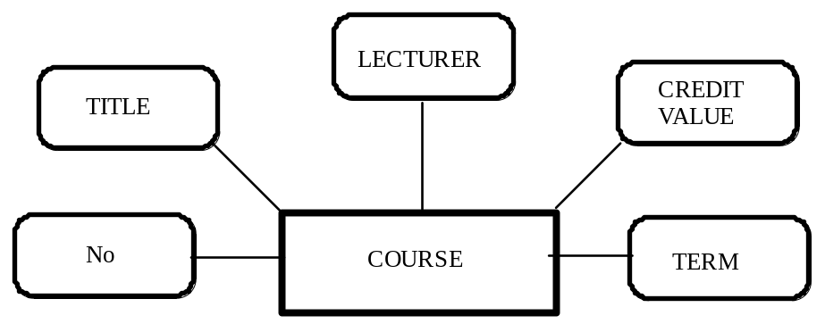
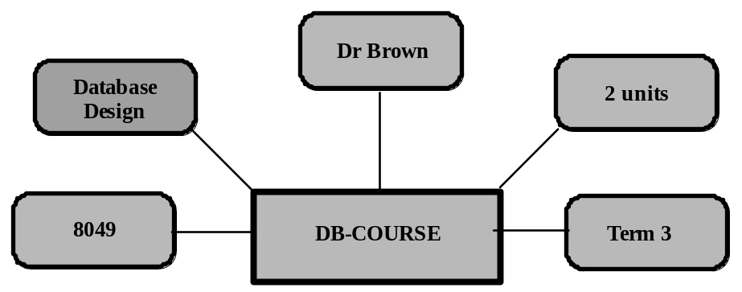
type
occurrence
©Stefan Stanczyk U08049 - 2008

Slide 22
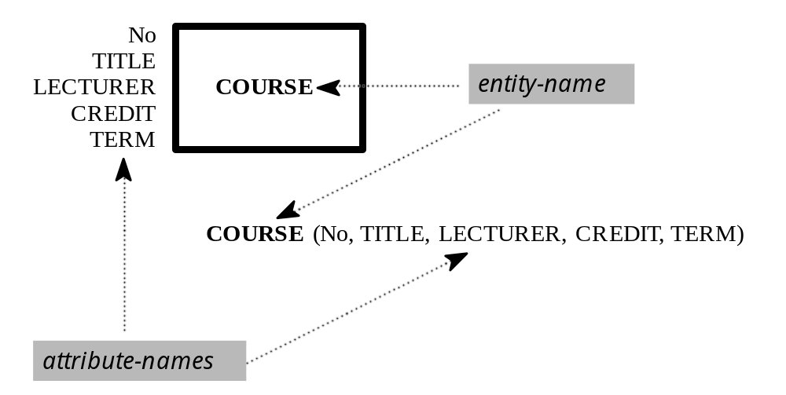
©Stefan Stanczyk U08049 - 2008

Slide 23
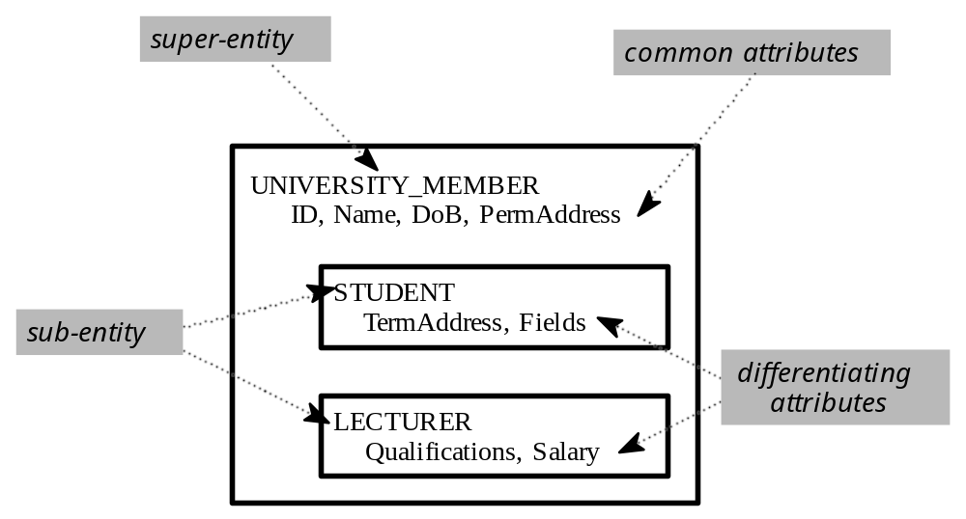
©Stefan Stanczyk U08049 - 2008

Slide 24
A relationship is a named directed mapping between two entity types
• one-to-one
an element from one class is mapped to
exactly one element in another class
• one-to-many
an element from one class is mapped to
one or more elements in another class
• many-to-many
zero, one or more elements from one class are mapped to
zero, one or more elements in another class, and vice-versa
©Stefan Stanczyk U08049 - 2008

Slide 25
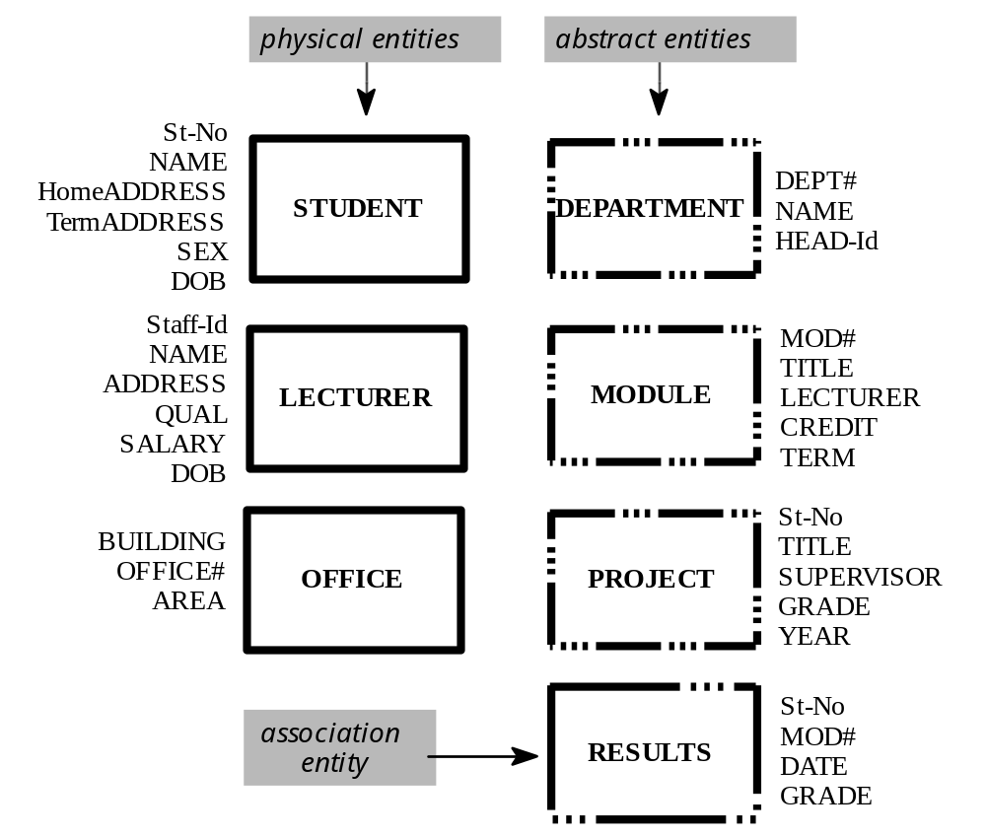
©Stefan Stanczyk U08049 - 2008

Slide 26
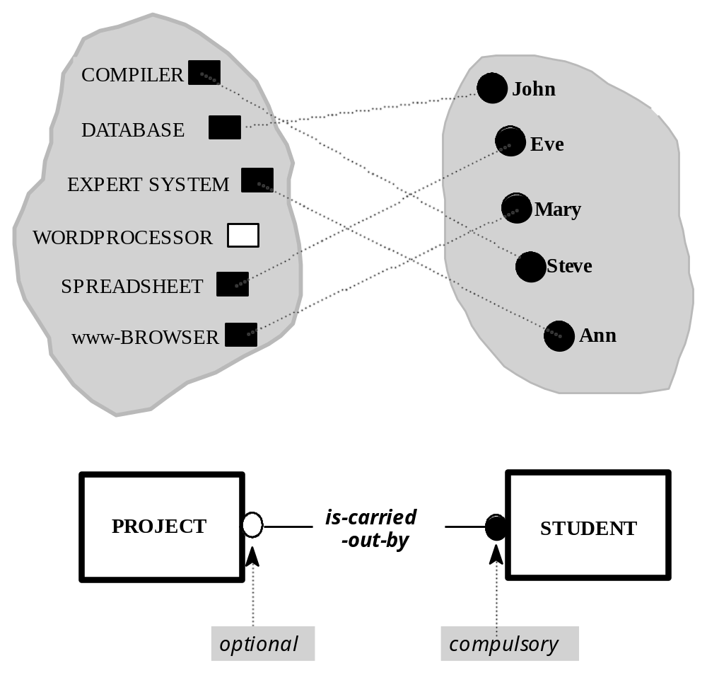
©Stefan Stanczyk U08049 - 2008

Slide 27
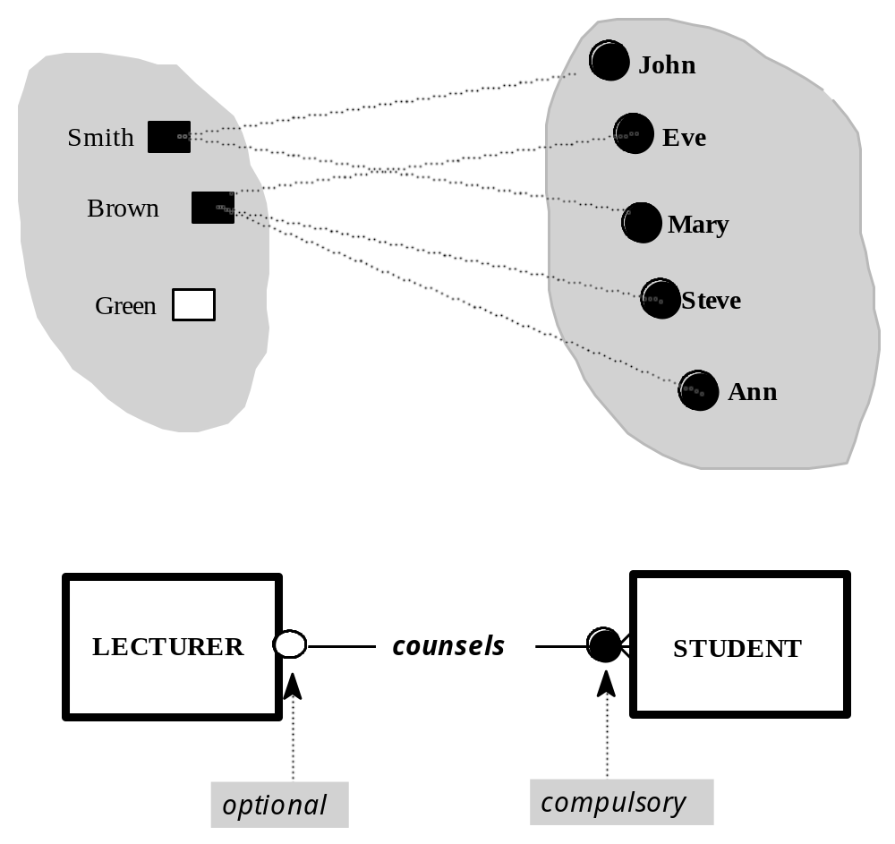
©Stefan Stanczyk U08049 - 2008

Slide 28
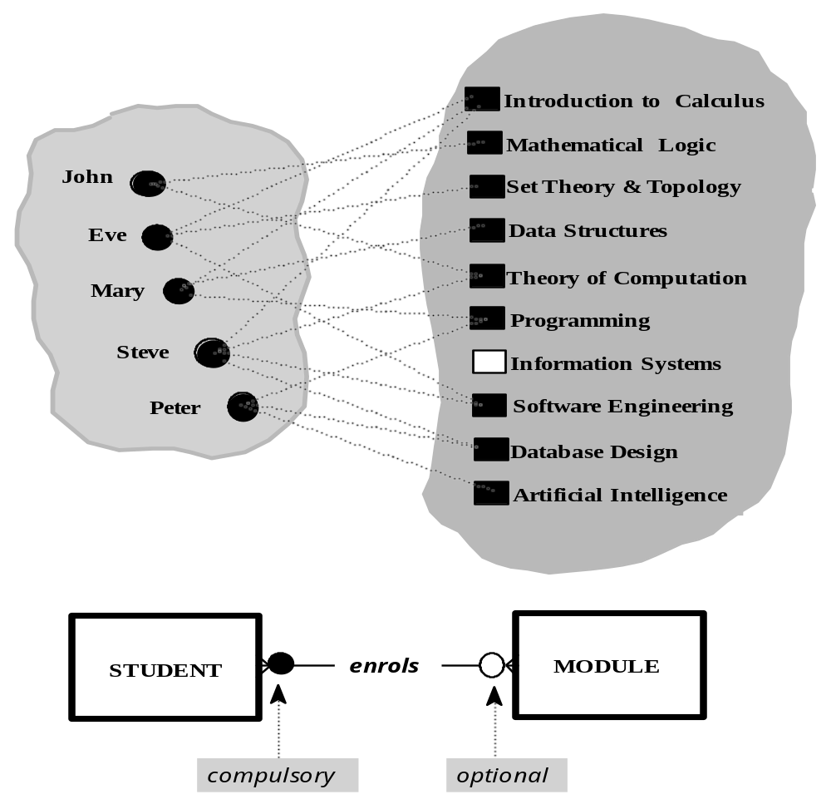
©Stefan Stanczyk U08049 - 2008

Slide 29
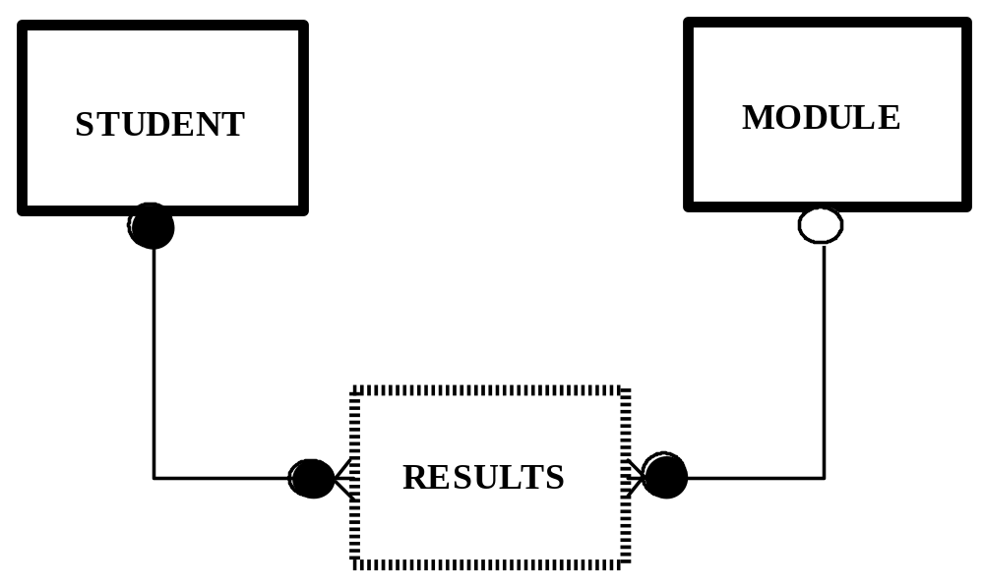
m:n decomposition
©Stefan Stanczyk U08049 - 2008

Slide 30
















super/sub entity
UNIVERSITY
MEMBER
carries_out
STUDENT
SYSTEM
PROJECT
LECTURER
has_account_on
supervises
©Stefan Stanczyk U08049 - 2008

Slide 31
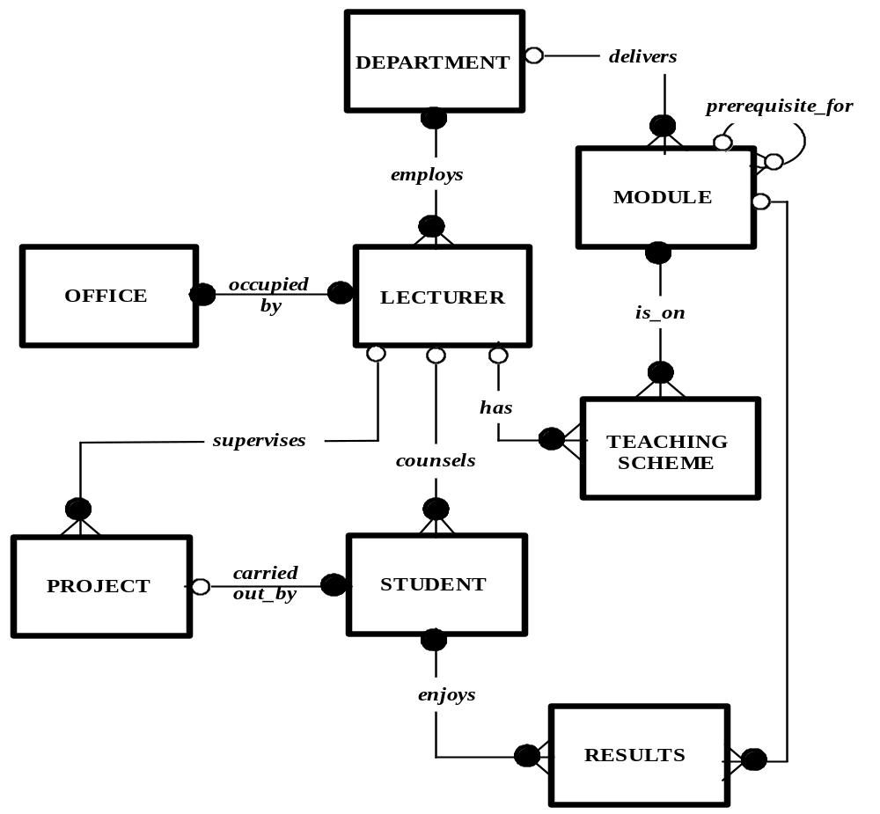
EAR DIAGRAM
©Stefan Stanczyk U08049 - 2008

Slide 32
TRANSACTION PROPAGATION - SIMPLIFIED SCHEME
delete lecturer X ::=
re-assign office to another lecturer
DEPARTMENT
re-assign project supervisor
for all projects supervised by X
MODULE
re-assign Personal Tutor
for all students counselled by X
OFFICE
LECTURER
update teaching scheme ::=
for all subjects taught by X
assign replacement lecturer;
if no suitable replacement
TEACHING
SCHEME
PROJECT
STUDENT
delete all modules affected ::=
re-assign prerequisites
delete records of affected
modules
RESULTS
delete record of lecturer X
©Stefan Stanczyk U08049 - 2008

